Slide 1
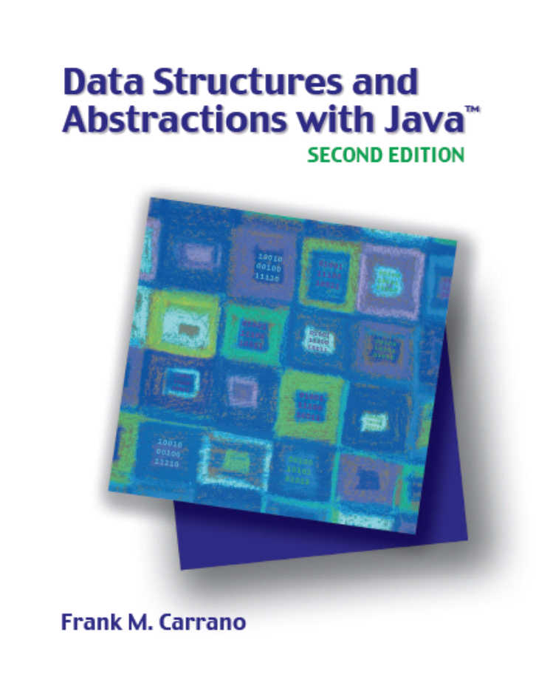

Faster Sorting Methods
Chapter 12
Slides by Steve Armstrong
LeTourneau University
Longview, TX
© 2007, Prentice Hall

Slide 2
Chapter Contents
Merge Sort
  Merging Arrays
  Recursive Merge Sort
  The Efficiency of Merge Sort
  Iterative Merge Sort
  Merge Sort in the Java Class Library

Slide 3
Chapter Contents
Quick Sort
  The Efficiency of Quick Sort
  Creating the Partition
  Java Code for Quick Sort
  Quick Sort in the Java Class Library
Radix Sort
  Pseudocode for Radix Sort
Comparing the Algorithms

Slide 4
Merge Sort
Divide an array into halves
  Sort the two halves
  Merge them into one sorted array
Referred to as a divide and conquer algorithm
  This is often part of a recursive algorithm
  However recursion is not a requirement

Slide 5
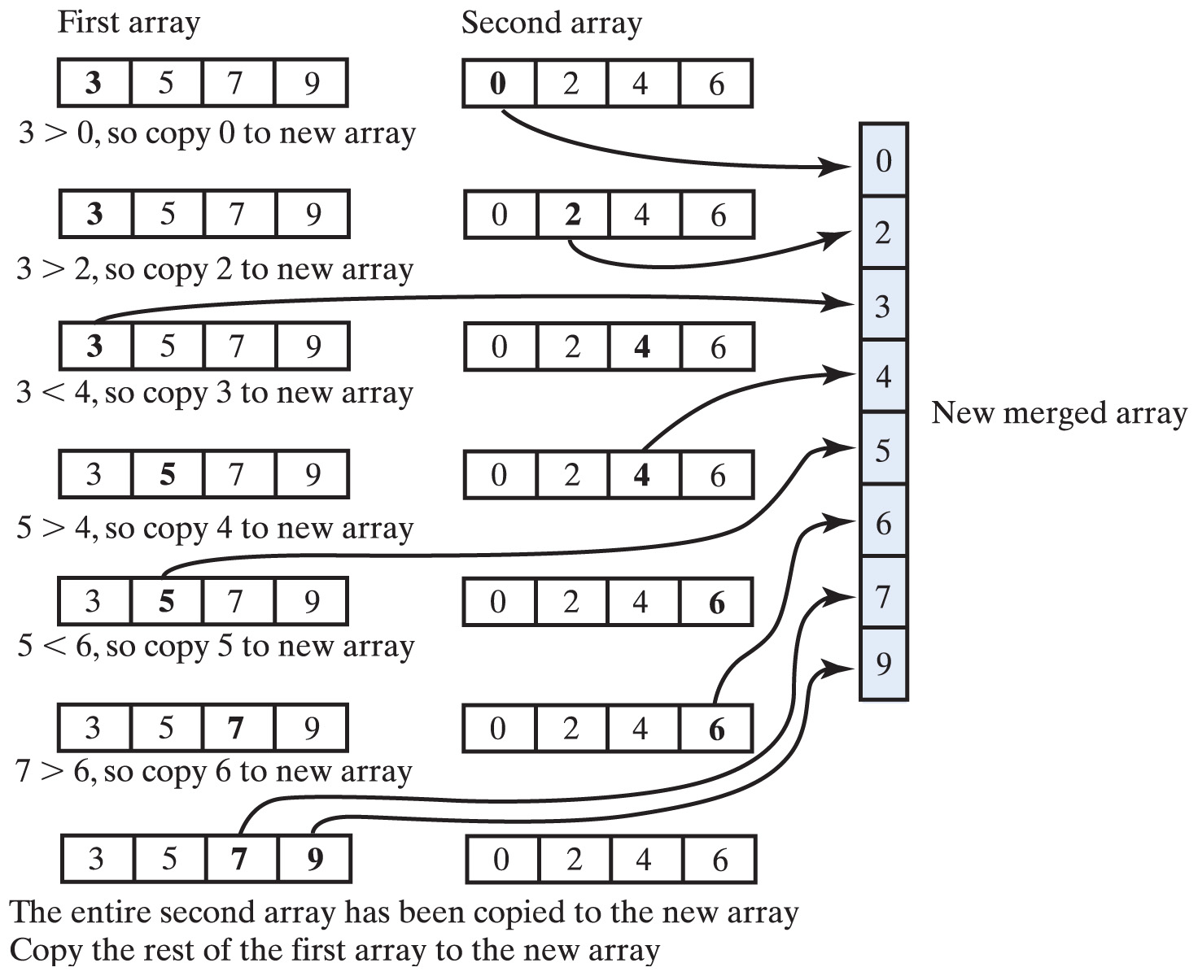
Merge Sort
Fig. 12-1 Merging two sorted arrays into one sorted array.

Slide 6
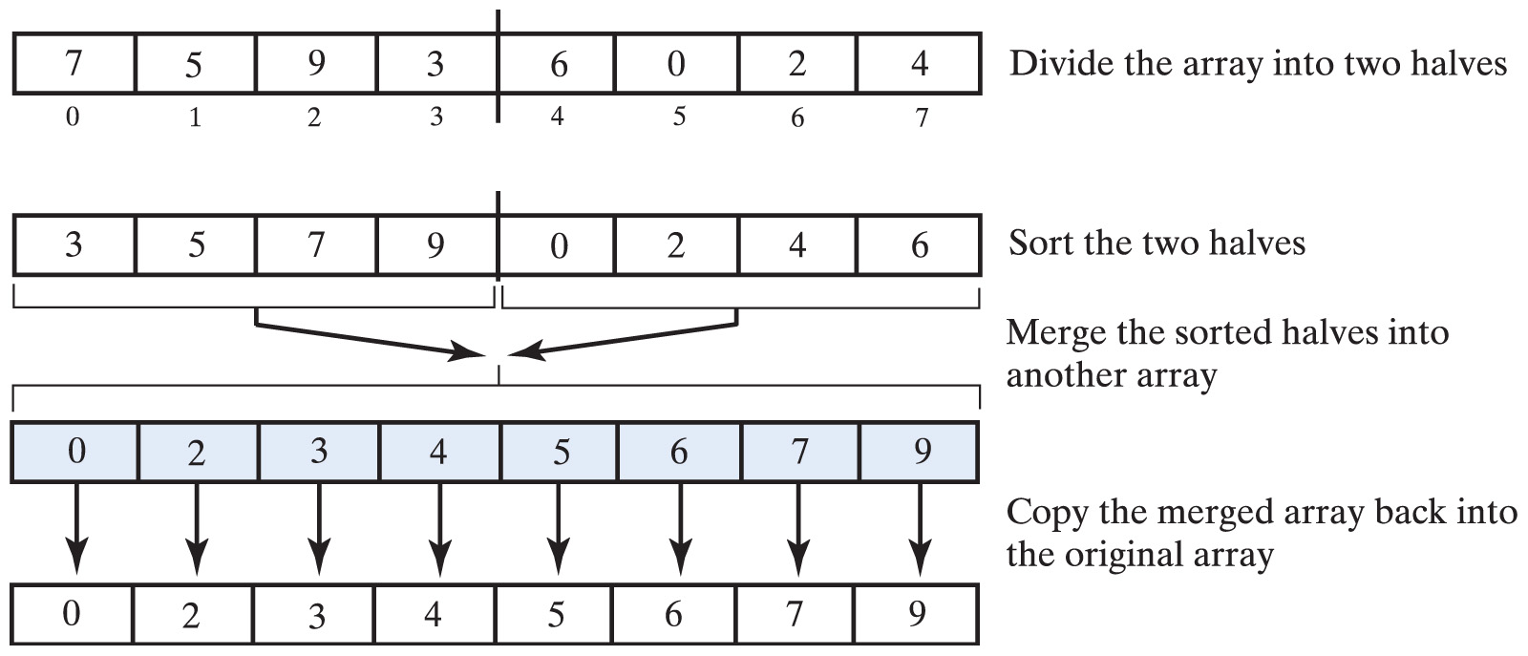
Merge Sort
Fig. 12-2 The major steps in a merge sort.

Slide 7
Merge Sort
View algorithms
  mergeSort
  merge which is used by mergeSort
Trace steps of the algorithm in Figure 12-3 on next slide

Slide 8
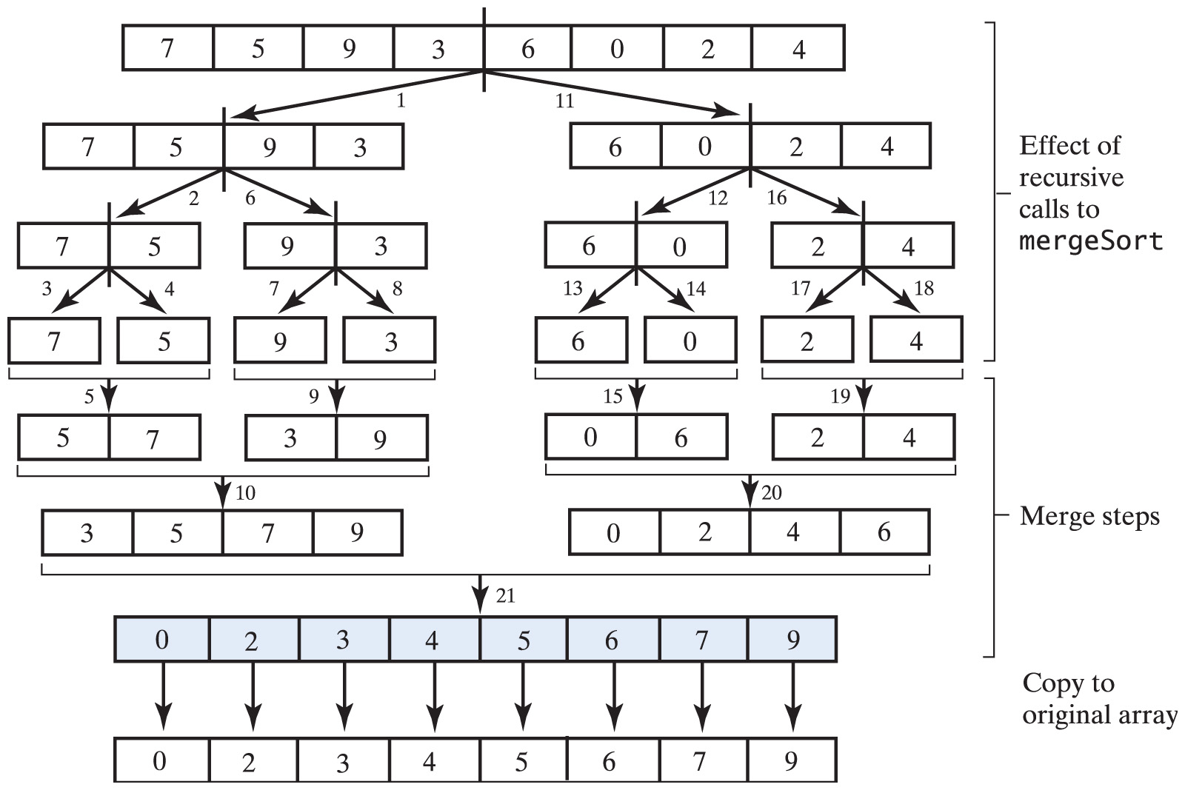
Merge Sort
Fig. 12-3 The effect of the recursive calls and the merges during a merge sort.

Slide 9
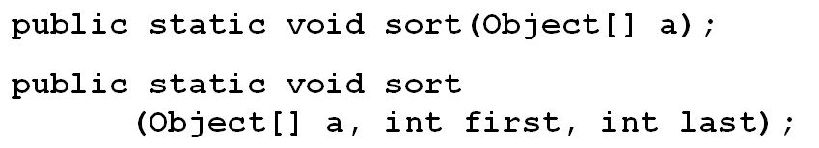
Merge Sort Efficiency
Merge sort is O(n log n) in all cases
  It's need for a temporary array is a disadvantage
Merge sort in the Java Class Library
  The class Arrays has sort routines that uses the merge sort for arrays of objects

Slide 10
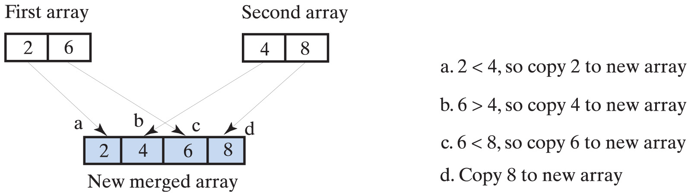
Merge Sort Efficiency
Fig. 12-4 A worst-case merge of two sorted arrays

Slide 11
Quick Sort
Divides the array into two pieces
  Not necessarily halves of the array
  An element of the array is selected as the pivot
Elements are rearranged so that:
  The pivot is in its final position in sorted array
  Elements in positions before pivot are less than the pivot
  Elements after the pivot are greater than the pivot

Slide 12
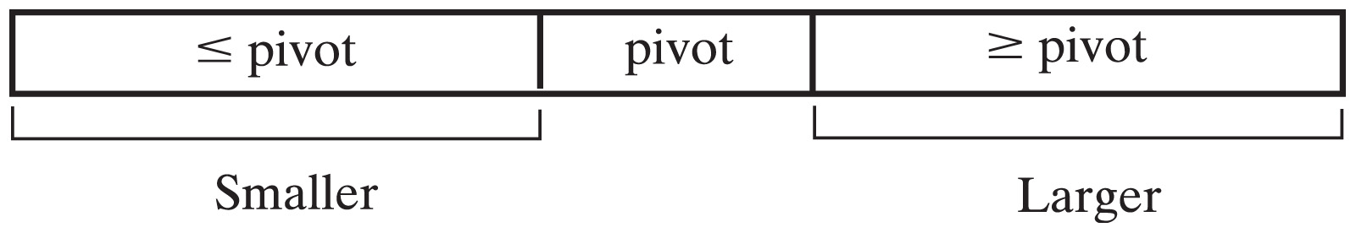
Quick Sort
View Quick Sort algorithm
Fig. 12-5 A partition of an array during a quick sort.

Slide 13
Quick Sort
Quick sort is O(n log n) in the average case
O(n²) in the worst case
Worst case can be avoided by careful choice of the pivot

Slide 14
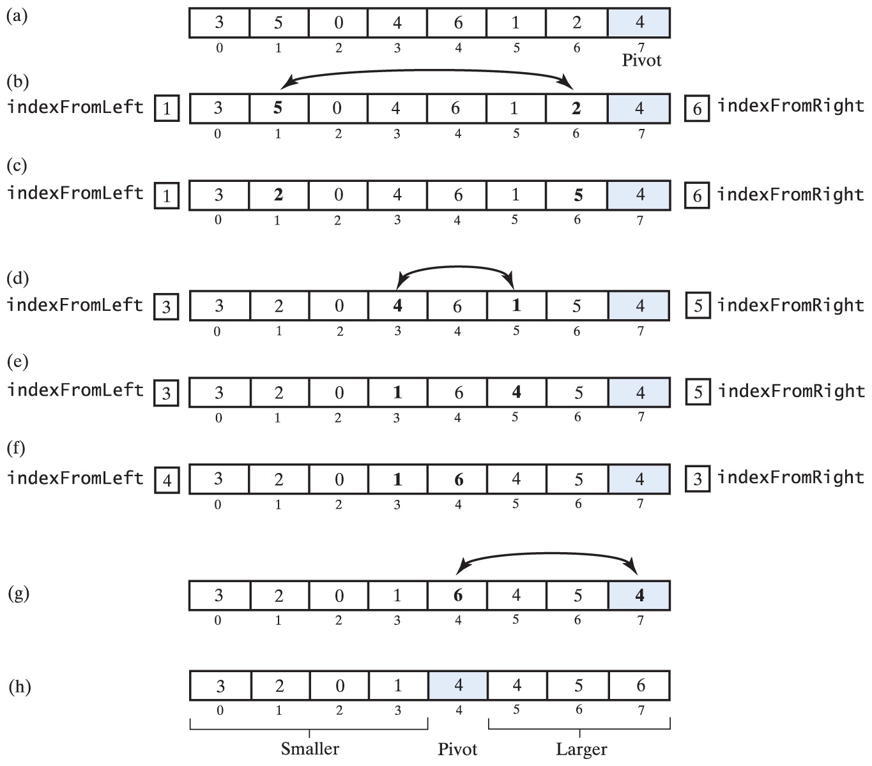
Quick Sort
Fig. 12-6 A partition strategy for quick sort … continued→

Slide 15
Quick Sort
Fig. 12-6 (ctd.) A partition strategy for quick sort.

Slide 16
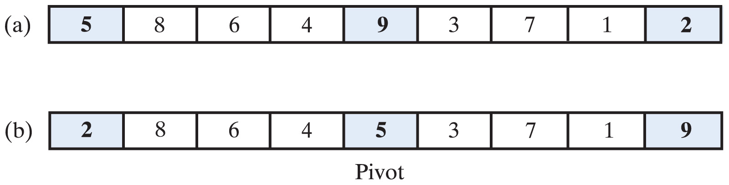
Quick Sort
Fig. 12-7 Median-of-three pivot selection:
(a) the original array; (b) the array with its first, middle, and last elements sorted

Slide 17
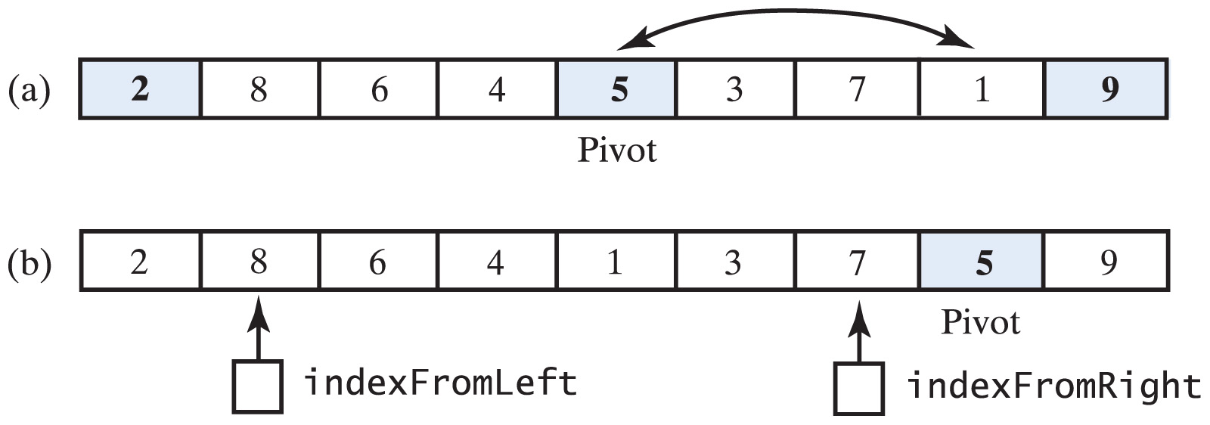
Quick Sort
Fig. 12-8 (a) The array with its first, middle, and last elements sorted; (b) the array after positioning the pivot and just before partitioning.

Slide 18
Quick Sort
Quick sort rearranges the elements in an array during partitioning process
After each step in the process
  One element (the pivot) is placed in its correct sorted position
The elements in each of the two sub arrays
  Remain in their respective subarrays
View Java code for Quick Sort
Note sort methods in java.util for Arrays class

Slide 19
Radix Sort
Does not compare objects
Treats array elements as if they were strings of the same length
Groups elements by a specified digit or character of the string
  Elements placed into "buckets" which match the digit (character)
Originated with card sorters when computers used 80 column punched cards

Slide 20
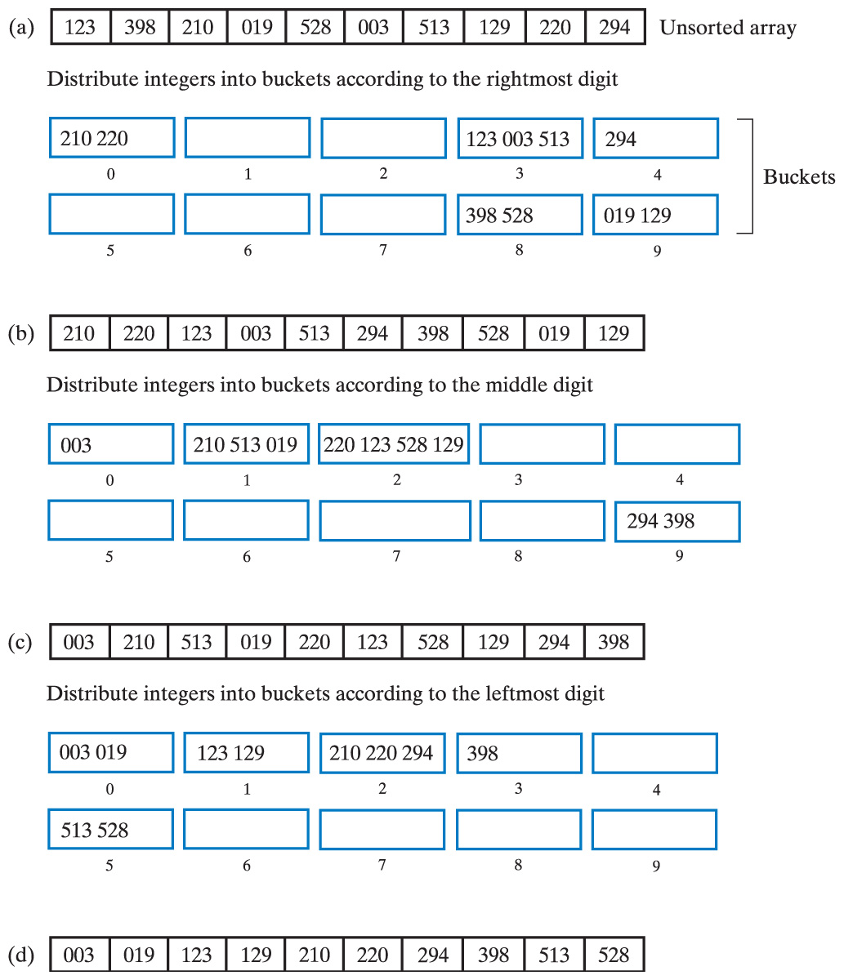
Radix Sort
Fig. 12-9 (a) Original array and buckets after first distribution; (b) reordered array and buckets after second distribution … continued →

Slide 21
Radix Sort
Fig. 12-9 (c) reordered array and buckets after third distribution; (d) sorted array

Slide 22
Radix Sort
View algorithm for Radix Sort
Note
  Radix sort is O(n)
  Can only be used for certain kinds of data

Slide 23
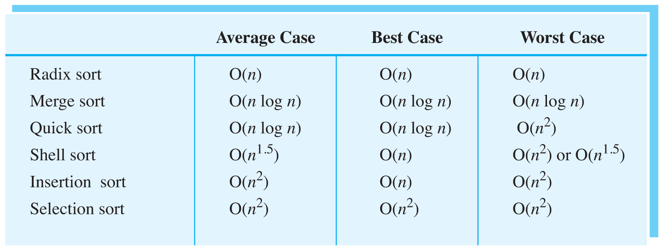
Comparing the Algorithms
Fig. 12-10 The time efficiency of various algorithms in Big Oh notation

Slide 24
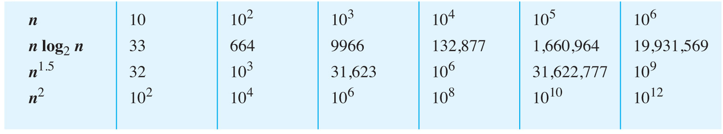
Comparing the Algorithms
Fig. 12-11 A comparison of growth-rate functions as n increases.

